Slide 1

Creating Custom Interactive Applications with R and Shiny
Chris Runyon, Josh Goodman,
and Marcus Walker
Day 1

Slide 2
Workshop Overview
Workshop Resources
https://tinyurl.com/NCMEShiny2021
Day 1: Basics
Day 2 Part 1: More Basics / Developing a Shiny App
Day 2 Part 2: App Development Resources
Additional Resources in above Github repository
Notes:
All resources available in listed github repository - also in email to all people who had signed up by SOME DATE
Day 1: Today - Overview of workshop, us, and Shiny. The rest of the day will be hands-on work where we will be walking you through building a simple shiny app. We will introduce the fundamental concepts today before adjourning. We asked that our workshop be split over a few days to allow you to have more time to revisit some of the material from the first day so you feel confident as we move into the second day’s work.
Day 2: Roughly split into 2 parts. The first part will pick up with the hand-on work that we started in Day 1 to demonstrate some additional features that you might want to incorporate into your app so you can extend the app’s functionality. The second part will largely be a demonstration to help you understand the breadth of Shiny’s capabilities. One of the beautiful aspect of R is the large user and developer community that builds packages that extend what R can do. Shiny is definitely no exception, so we want to highlight a few of the keys areas where you can make improvements to your Shiny app to really get it where you want to be. We’ll also visit some of the winners of the R Studio Shiny App competitions - these not only help you see a really well-done, comprehensive Shiny app, but also to see what is possible with Shiny. It’s this second part - what is possible with R - that I found to be really exceptional - when I first read through posts about the winners it showed me that I still had a really narrow vision of what was possible with Shiny.
As Hadley Wickham states in his “Mastering Shiny” book - “Shiny is designed to feel almost magically easy when you’re getting started, and yet the deeper you get into how it works, the more you realize it’s built out of general building blocks that have strong software engineering principles behind them.”
Onward!

Slide 3
Logistic Details
Learning Shiny - like many things - requires having a bit of tolerance for ignoring the things you that aren’t covered until they are covered / you can look them up later.
The app has several components / aspects to it, really no other way to cover the material.
This workshop has several hands-on components / in-class activities.
Notes:
Point 1 - Like going to a new conference at the boundaries of your knowledge.
Point 2 - We’ll adapt as we go along until we figure it out.
Point 3 - My internet has been acting up a little this week - nothing big, but I personally may have some hiccups when presenting.

Slide 4
Day 1 Learning Objectives
Be able to describe the basic shiny environment.
Have a basic understanding of the fundamental aspects of the layout of a shiny app and be able to manipulate these layouts.
Have a basic understanding of the input() and output() components of a shiny app and be able to select and utilize these commands.
Know how to incorporate tabular and graphical displays into your shiny app.
Will learn how to download / export tables and graphics.
Have an initial understanding of the reactivity components of shiny.

Slide 5



Brief Introduction
Chris Runyon, Measurement Scientist, NBME
crunyon@nbme.org
Josh Goodman, Senior Director of Psychometrics Test Development, NCCPA
joshuag@nccpa.net
Marcus Walker, Data Scientist, NCCPA
marcusw@nccpa.net
Notes:
Each introduce ourselves?

Slide 6
What is Shiny?
“Shiny is an R package that makes it easy to build interactive web apps straight from R. You can host standalone apps on a webpage or embed them in R Markdown documents or build dashboards. You can also extend your Shiny apps with CSS themes, htmlwidgets, and JavaScript actions.” - https://shiny.rstudio.com/
It is an interface to help you, your colleagues, your clients, and your customers to be able to do something without having to know any R programming.
something = access information / data, enter information / data, perform an analysis, create a report, etc.

Slide 7
What is Shiny?
Shiny utilizes R syntax as a shortcut to write HTML / CSS / JavaScript.
No knowledge of these languages is necessary to create your app.
Gaining some small knowledge of one of these languages can extend your Shiny functionality.
Knowing (or having a colleague that is fluent) in these languages can significantly extend the capabilities of the app.

Slide 8
Why use shiny?
Take it away Josh!

Slide 9
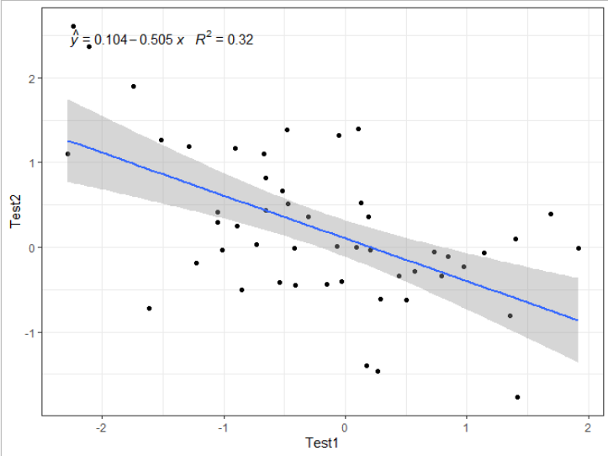
A
Simple
Shiny
App

Slide 10
Shiny apps are just R code
A Shiny application is developed using the same basic R coding methods you currently use, but with some package specific functions.
We can leverage what we already know about R and make use of it within our applications.
You can use your favorite packages within Shiny applications.
You can use build an implement custom functions within applications.
Your data wrangling tricks will still work.

Slide 11
Shiny apps are just R code
Let’s consider a task that we might tackle with some routine R coding.
We want to generate some bivariate data.
We want the two variables to have a known correlation.
Our desired output is a scatter plot that shows the a line of best linear fit and a confidence interval around that line.

Slide 12
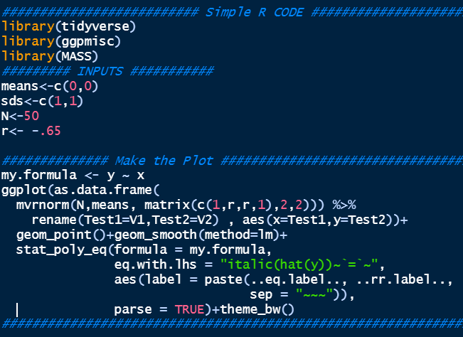
Simple R code

Slide 13
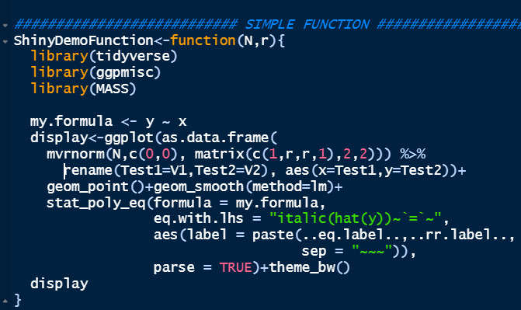
As a function
If we wanted to simulate data with new parameters, we’d have to change our inputs and rerun the code.
If this was task we would need to run repeatedly or we wanted to incorporate it into some larger context, we might turn it into a function.

Slide 14
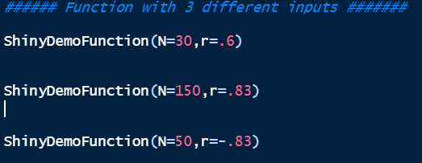
As a function
As a function, we can easily manipulate our arguments to produce plots.
We could embed and use the function in other code.
We would be actively working within R.
We would need to execute the code repeatedly to see new plots.

Slide 15
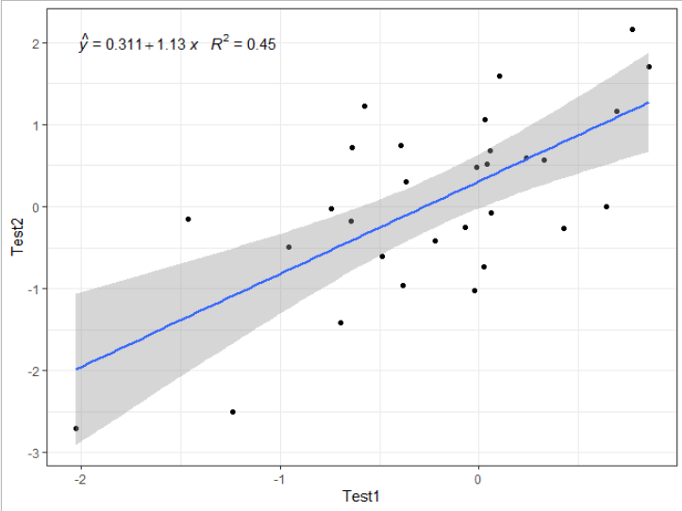
As a function

Slide 16
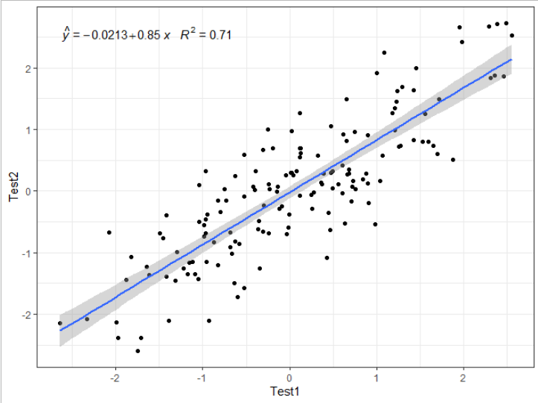
As a function

Slide 17
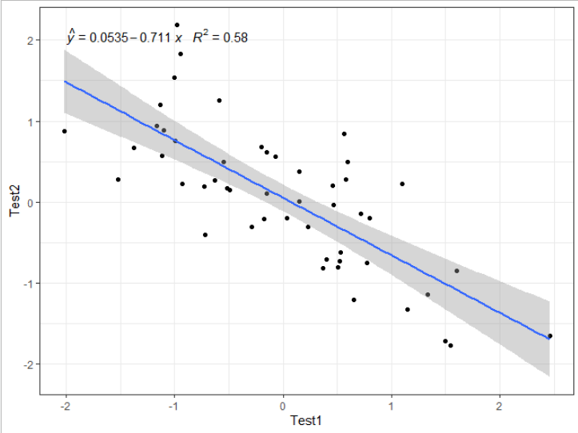
As a function

Slide 18
The same task...but as a Shiny app
We can use the same base code to create a Shiny app.
The app can rerun the simulation and generate a new plot without executing the code over and over.
We can make the simulation interactive--as we manipulate the inputs, we can see changes in the output
Let’s check out the app version of this task (0_simpleApp.r)

Slide 19
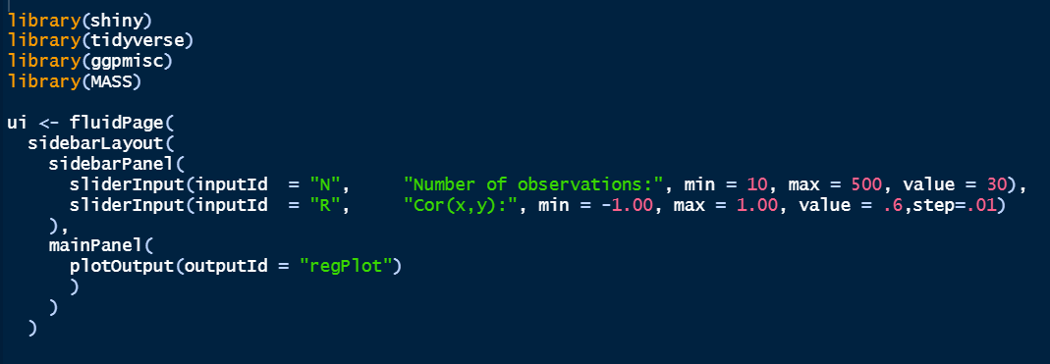
Peeking under the hood

Slide 20
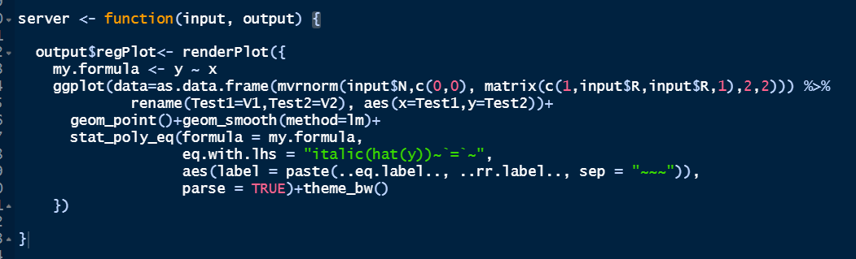
Peeking under the hood

Slide 21
Shiny is an analytic solution
We can build internal applications and professional-looking external tools.
The ability to create custom application is limited only by your R and Shiny programming skills.
Applications are shareable—tasks can be completed by any user, at anytime, with predictable outcomes.
Once an app is published or shared, reliance on R is minimized.

Slide 22

Building Your Shiny App

Slide 23
What is in a Shiny application?
library(shiny)
ui <- fluidPage()
server <- function(input, output) {}
shinyApp(ui = ui, server = server)
User Interface - controls layout and appearance
The engine of the app
Function that launches the app locally

Slide 24
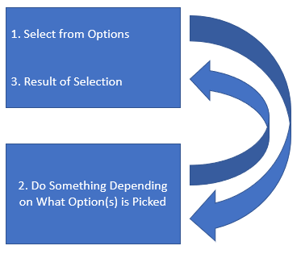
UI and Server
UI = User Interface
Preset options for what the user can do.
Result of what the user does.
Server
Takes the information from the preset options, does something to that information, and then returns the result of that something back to the user.

Slide 25
UI
Server
Layout Functions - set up the visual structure of the page
Input Control - lets the user interact with the app
Output Control - where the output will appear on the UI
A function that takes the information provided by the input controls and produces the output

Slide 26
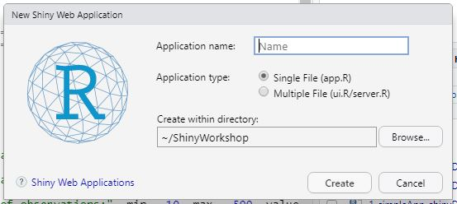
UI and Server
Two options for structuring the Shiny app:
Single File
Multiple File
Notes:
Single File = good for learning Shiny, simple apps, testing new features, etc.
Multiple File = good for complex apps, in scenarios where different people are working on the UI and server, etc.

Slide 27
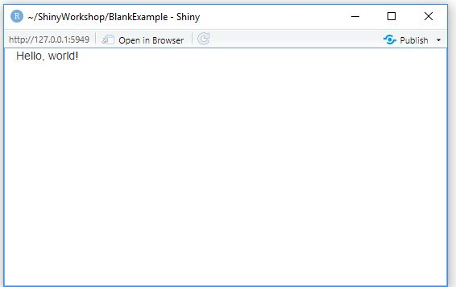
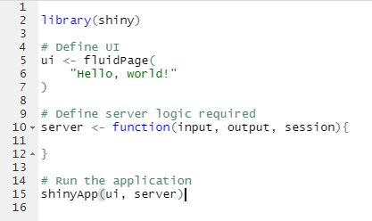
UI and Server (HelloWorld.R)
Notes:
Directions for “Run App”

Slide 28
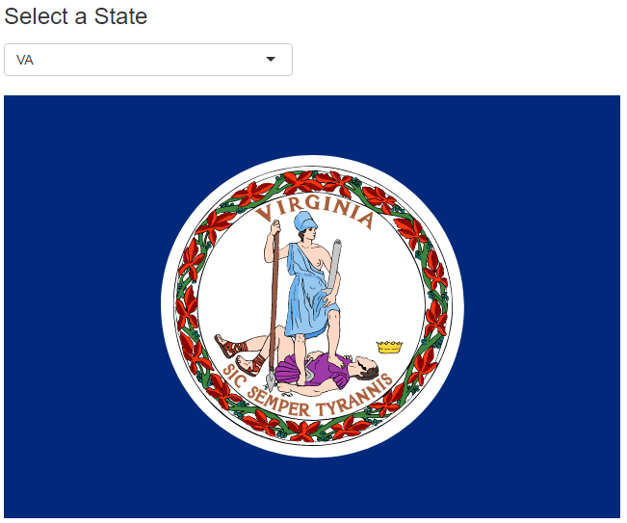
UI and Server (PickState.R)

Slide 29
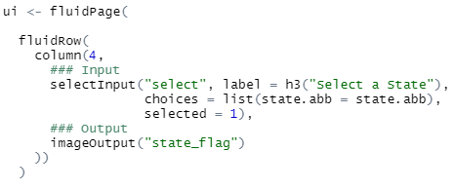
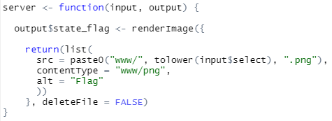
UI and Server (PickState.R)

Slide 30
UI and Server (PickState.R)
Input
Output

Slide 31
Layout
The layout of the shiny app is the basic visual structure of the page. The layout is shiny is powered by Bootstrap, which is a popular (and powerful) HTML/CSS framework.
The layout can range from very simple (such as the PickState.R example) to the very complex.
Basic concepts now. On Day 2, after learning more about the inputs, outputs, reactivity, etc. of Shiny, we will introduce some more complex layout options.

Slide 32
fluidPage()
This is the container for your UI. Sets up HTML, CSS, and JavaScript behind the scenes to enable easy programming in shiny.
fluidPage() - width is fluid; width of the app depends on components specified in the other parts of the UI
fixedPage() - utilizes a maximum fixed width; prevents display from being too wide
fillPage() - helps to fill the whole screen
Especially helpful when you expect users to be on a variety of devices / interfaces.

Slide 33
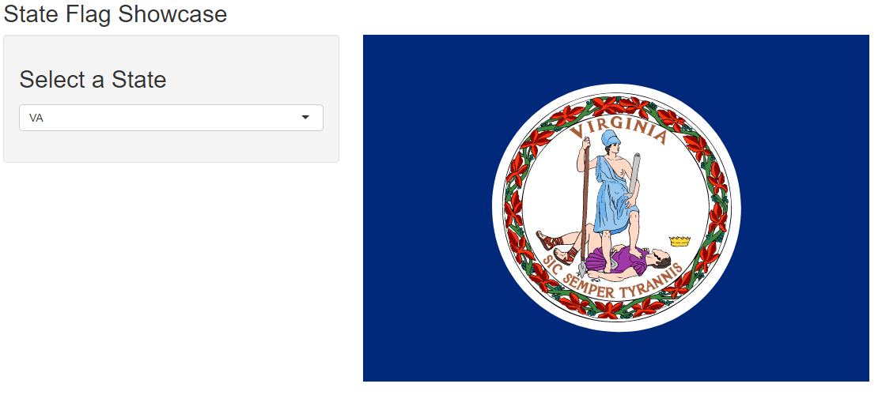
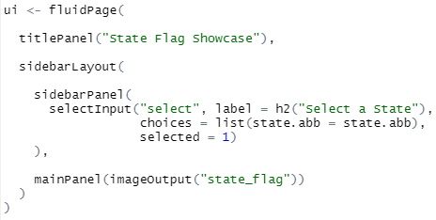
sidebarLayout() (PickStateSidebar.R)
Divides the app into a sidebarPanel and a mainPanel, which are displayed side-by-side.

Slide 34
Grid Layout
The Bootstrap system on which shiny is based works off a 12-wide grid system.
You can specify widths of panels in fluidRows; needs to add up to 12. If the objects in your rows exceed 12, the object(s) exceeding 12 are put onto another row.
We can re-create the sidebarLayout() above using the grid layout system.

Slide 35
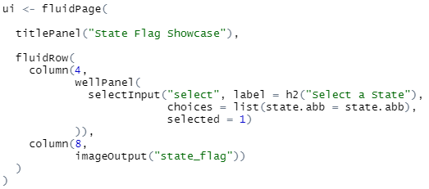
Grid Layout (PickStateGrid.R)

Slide 36
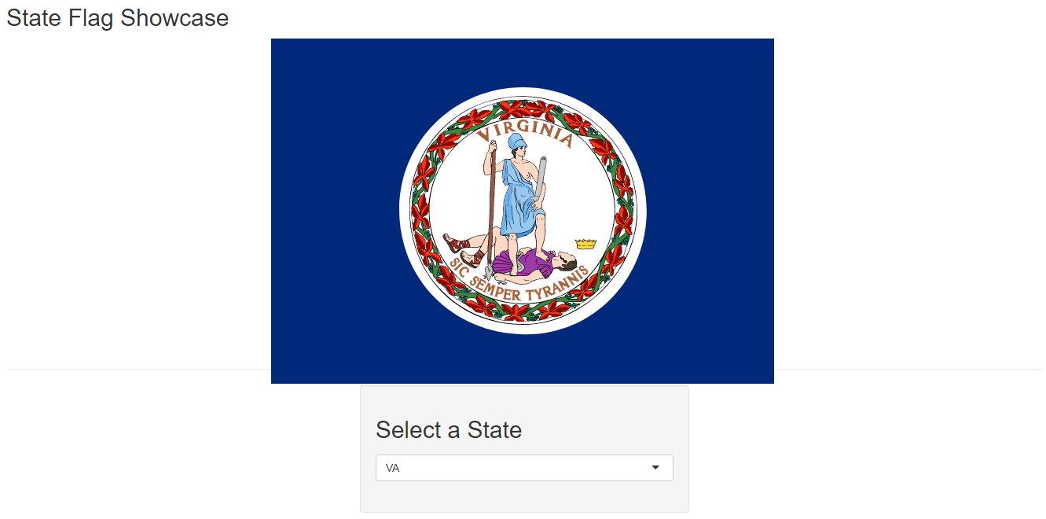
Grid Layout (PickStateGridTopFlag.R)

Slide 37
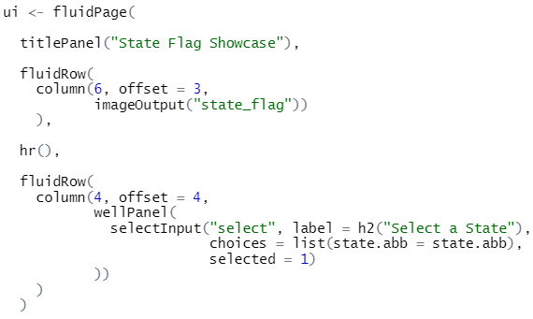
Grid Layout (PickStateGridTopFlag.R)

Slide 38
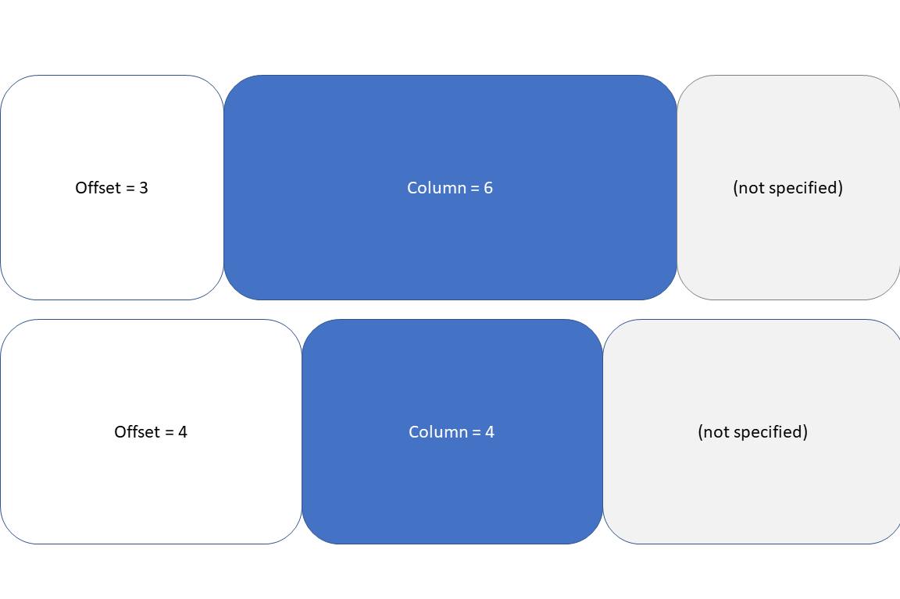
Grid Layout (PickStateGridTopFlag.R)

Slide 39
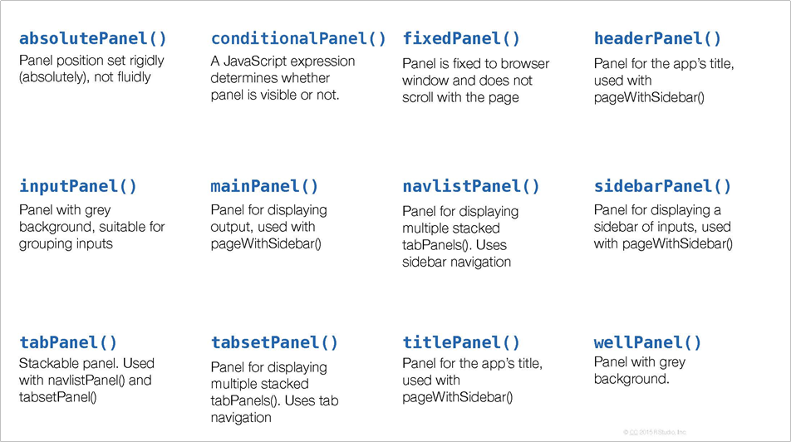
...Panel()

Slide 40
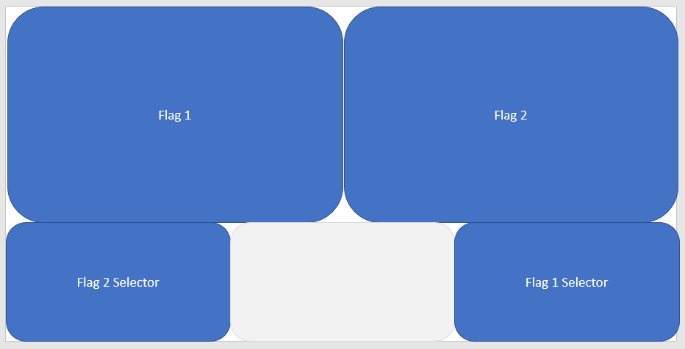
Activity 1a
Make an app where the top row is 2 state flag outputs, the bottom row is two selection bars spaced at both ends of the row, AND the selection bar under the left flag controls the right flag and vice versa.

Slide 41
Activity 1a Solution

Slide 42
Themes
Themes are a quick and easy way to change the styling of the shiny app.
“styling” = font, colors of the different elements
The ‘shinythemes’ package is one of the quickest ways to change the theme of your package / layout.

Slide 43
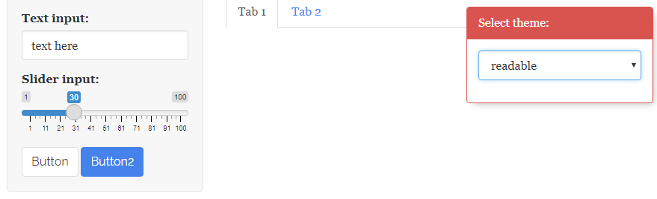
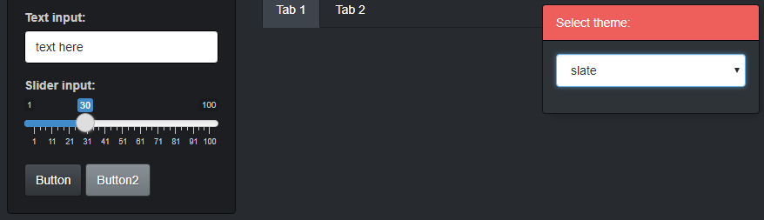
shinytheme examples (shinythemeExamples.R)

Slide 44
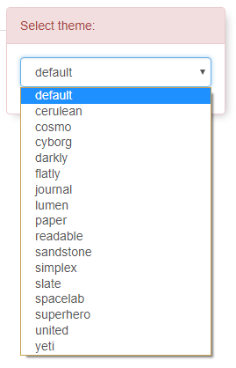
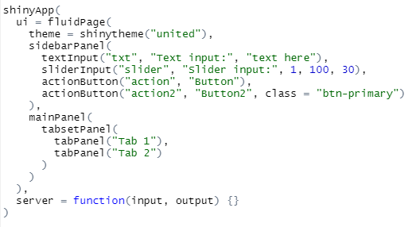
shinytheme examples (shinythemesUnited.R)

Slide 45
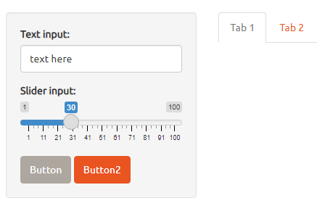
shinytheme examples (shinythemesUnited.R)

Slide 46
Themes
Themes are a quick and easy way to change the styling of the shiny app.
“styling” = font, colors of the different elements
The ‘shinythemes’ package is one of the quickest ways to change the theme of your package / layout.
“bslib” package - “bootstrap library” - additional themes / customizing elements of the themes
Works off of the Bootstrap framework mentioned earlier

Slide 47
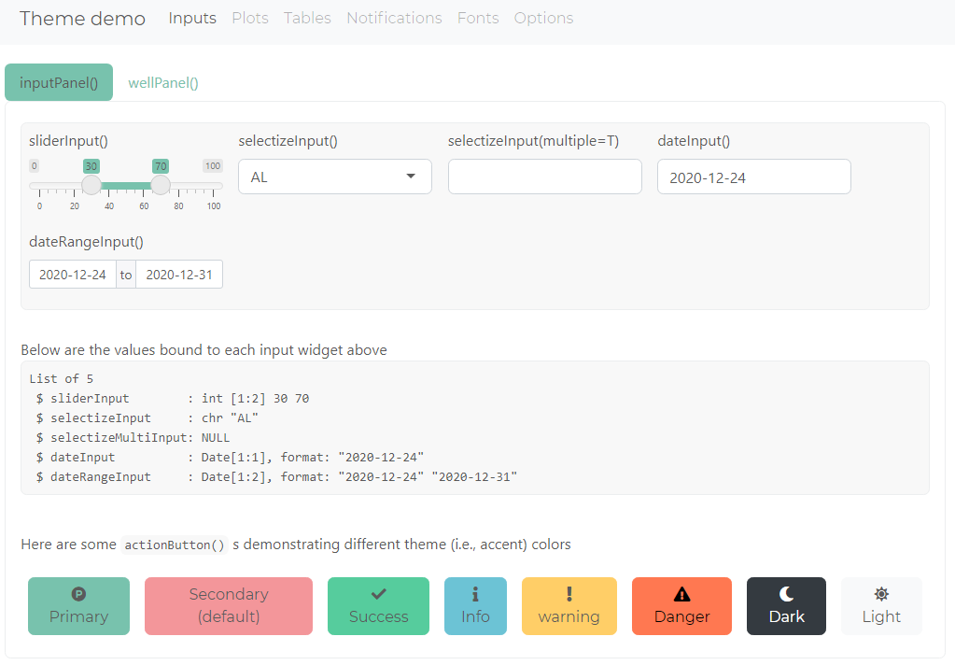
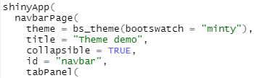
bslib - preset theme example (bslibMinty.R)
Notes:
Note that this does require that “global.R” is also in the same folder. May also require you to install additional packages that we didn’t explicitly include in the pre-workshop instructions.

Slide 48
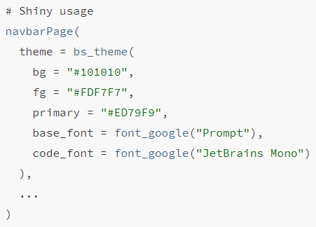
bslib - changing elements
pssst…. fonts.google.com is awesome!

Slide 49
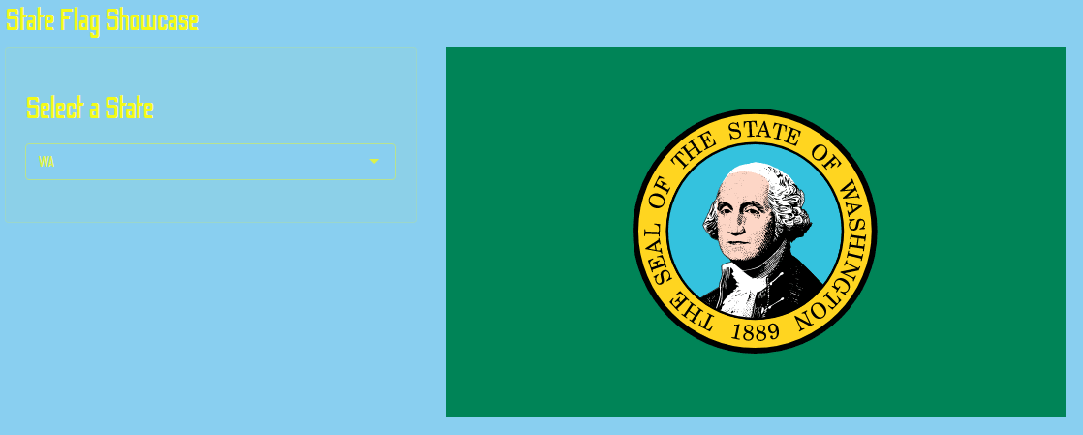
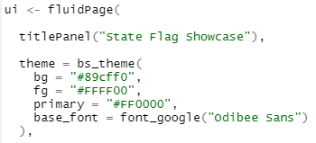
bslib - changing elements (PickStateSidebarBSLIB.R)

Slide 50
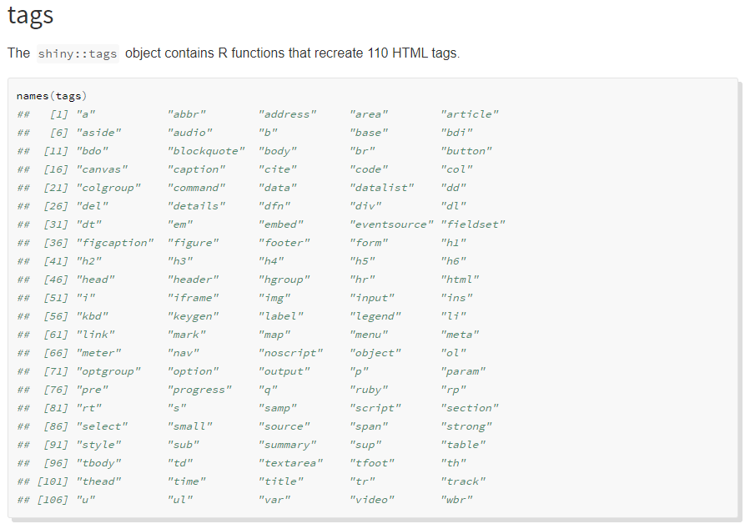
Tags - Shiny HTML Tags Glossary

Slide 51
What is Shiny? - a tags example
“Shiny is an R package that makes it easy to build interactive web apps straight from R. You can host standalone apps on a webpage or embed them in R Markdown documents or build dashboards. You can also extend your Shiny apps with CSS themes, htmlwidgets, and JavaScript actions.” - https://shiny.rstudio.com/
It is an interface to help you, your colleagues, your clients, and your customers to be able to do something without having to know any R programming.

Slide 52
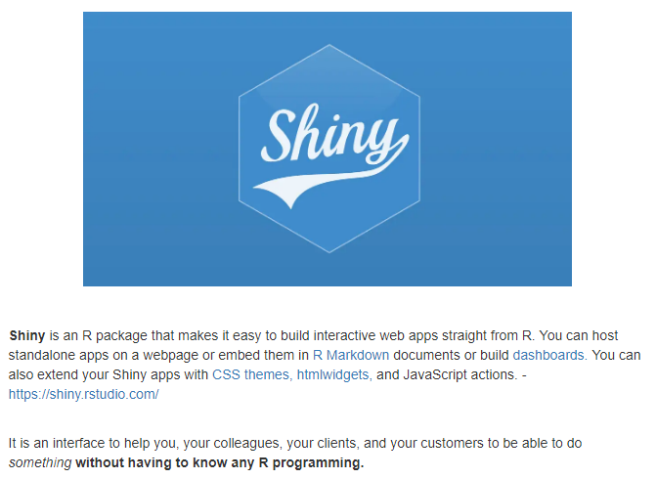
What is Shiny? (AboutShiny.R)

Slide 53
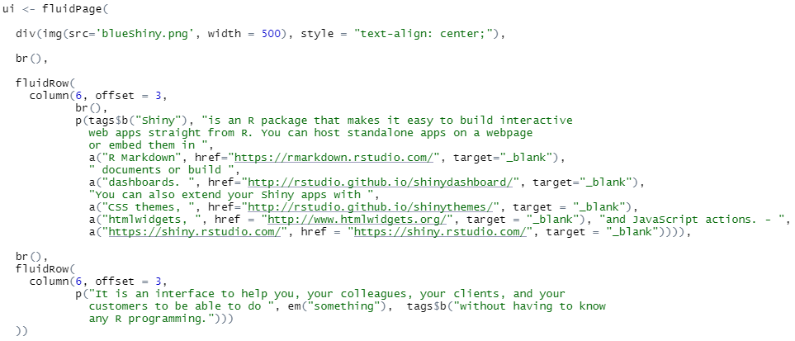
What is Shiny?

Slide 54
Images
Including images in a Shiny app is easy. The only trick is that images need to be included in a folder named “www” in the same directory where your app is located (check out the www folder in the PickState folder).
This default behavior can be changed / overridden, but I’ve never had a need to do so. There are also additional ways to include images, but this has always worked fine for me.

Slide 55
Activity 1b
Make a Shiny page with a State Flag image, some detail about why you chose that flag (where you live / work / were born / favorite place to visit, etc.), and then a hyperlink - in italics - that takes the Shiny user to something related to that page (state tourism page, favorite restaurant, etc.).
You must use at least 2 rows and/or the sidebar layout.
You do not include any inputs; the server should be empty.
Update that page by changing the color of the background and the font used on the page.

Slide 56
Activity 1b Solutions

Slide 57
Shiny Inputs and Outputs

Slide 58
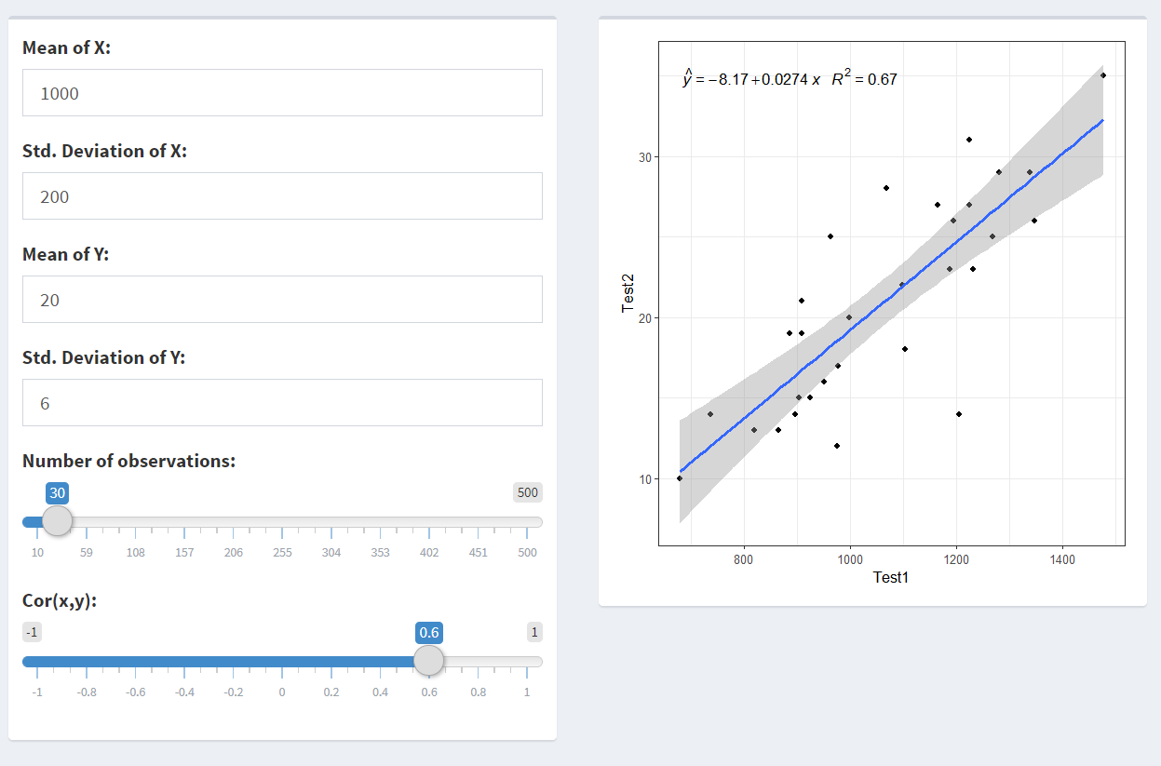
Shiny Inputs and Outputs
Input Functions:
*Input()
numericInput()
textInput()
sliderInput()
selectInput()
dateInput()
...
Output Functions:
*Output()
plotOutput()
dataTableOutput()
textOutput()
htmlOutput()
uiOutput()
...
Notes:
__Input(), __Output(), render*()
Basic ones part of the {shiny} package but more are available especially for outputs
Not always as exciting looking but can be customized with CSS or R Packages

Slide 59
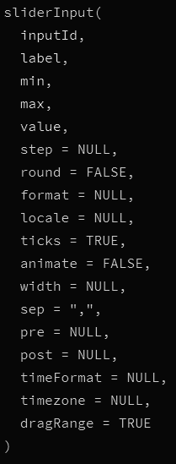
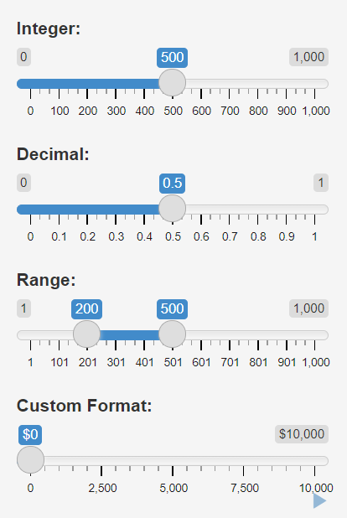
Input Function Structure
Common and Required Inputs:
sliderInput(inputId,
label,
...
)
Full input list (including ones with defaults)
https://shiny.rstudio.com/reference/shiny/latest/sliderInput.html
Sometimes there are differences based on the Shiny package version
Notes:
inputId and label required for all shiny inputs
library(shiny)
sliderInput Pull up the inputs in the console at the start of the activity so they can see it, both with the code lines about AND ?sliderInput

Slide 60
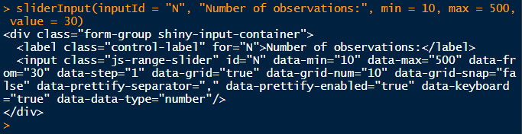
What the Input Functions Do
Generate the HTML so you don’t have to
Signal to Shiny that something has changed
Many functions used in the Shiny UI generate HTML like this
Notes:
inputId and label required for all shiny inputs

Slide 61
Rules for accessing your inputs
Access like a list (or similar to a dataframe):
input$
Input[[ ]]
MUST be accessed in a reactive component inside the server code
ui
checkboxInput(inputId = "check1",
label = “Choice A”)
server
input$check1
Notes:
(Prob don’t mention, too advanced...) It’s possible to use inputs to affect your UI through renderUI() and conditionalPanel but that’s more advanced
https://shiny.rstudio.com/reference/shiny/latest/checkboxInput.html

Slide 62
Activity: Add inputs to your UI (2a_AddInputs.R)
Add a sliderInput() using some information from the dataset
inputId = “sliderValue”
Add a selectInput() using some information from the dataset
inputId = “selectValue”
label
choices = loadedData$Month
Assess the values returned in your outputs to see the differences
Make your slider input provide a range rather than a single value
Hint: value = c(1, 10)
Explore how to modify selectInput()
Examples: https://shiny.rstudio.com/gallery/selectize-vs-select.html
Get creative!
Notes:
IMPORTANT: show the app template first AND show them what happens when you’re missing a comma between sequential parts of the UI since it’s like all pieces are being passed into a function.
Example to paste into CONSOLE:
mainPanel()
mainPanel(tags$p())
These are the least descriptive inputId names ever, but they will connect to the outputs already set up

Slide 63
Available Inputs: Shiny Widgets Gallery
Explore:
Input options
The object type of the returned value
Code to add it to your app
Go to: https://shiny.rstudio.com/gallery/widget-gallery.html
{shiny} Input Types:
Free text:
textInput()
passwordInput()
textAreaInput()
Numeric:
numericInput()
sliderInput()
Dates:
dateInput()
dateRangeInput()
Set choice:
selectInput()
radioButtons()
Upload files:
fileInput()
Action buttons:
actionButton()
Notes:
(no longer using in this section) How to run w/ Showcase mode: shiny::runApp('C:/Users/marcusw/Downloads/1_inputTestingApp.R', display.mode="showcase")

Slide 64
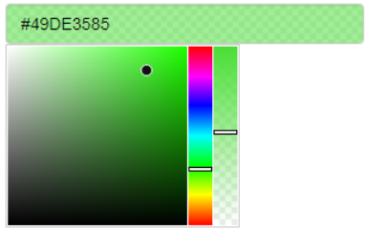
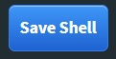
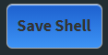
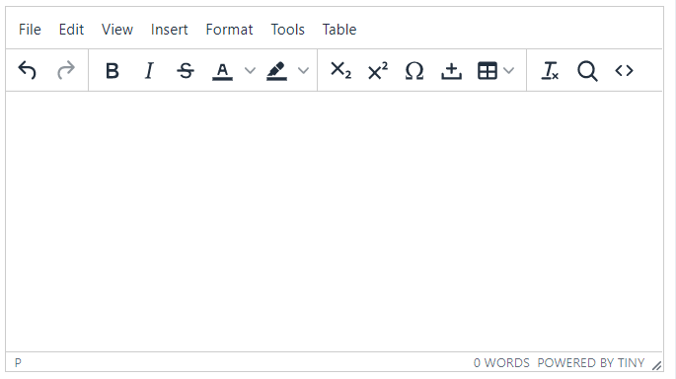
Spice up your inputs
All Shiny Gallery Examples: https://shiny.rstudio.com/gallery/
Interactive Button Styler - Includes the colourInput from {colourpicker} https://shiny.rstudio.com/gallery/button-styler.html
selectInput() and it’s many, many options: https://shiny.rstudio.com/gallery/selectize-examples.html https://shiny.rstudio.com/gallery/selectize-vs-select.html https://shiny.rstudio.com/gallery/option-groups-for-selectize-input.html https://shiny.rstudio.com/articles/selectize.html
https://cran.r-project.org/web/packages/colourpicker/vignettes/colourpicker.html
Notes:
Quick slide (mostly as later reference materials and showing the Button Styler app)
CSS properties, packages you can use or custom shiny inputs
Hover over and click-event changes for inputs like buttons (“Save Shell” action button input shown)

Slide 65
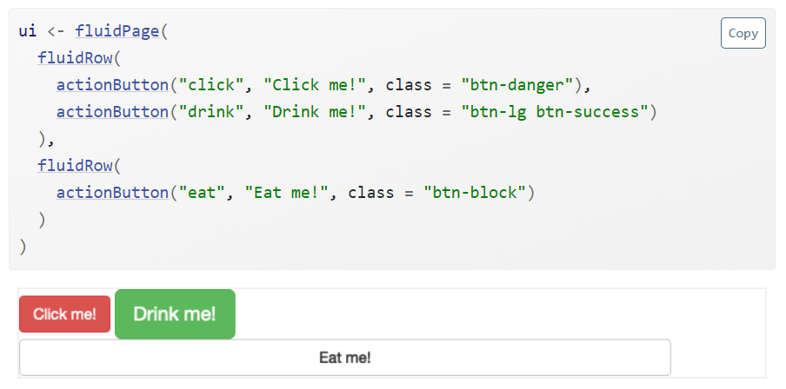
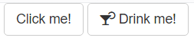
How Are Action Buttons Different?
With buttons, it’s better to write code that will happen when the button is click than to try to use the VALUE of the button input.
observeEvent(input$MyButton, {
....
})
Rather than:
buttonCount <- input$MyButton
https://mastering-shiny.org/basic-ui.html#action-buttons

Slide 66
Outputs
Act like functions that re-run when an input changes (and they are viewable on the page -- lazy evaluation).
Two components:
UI Side: A location in your app
Server Side: Render function telling Shiny what to show
output$* <- render*({ })
ui (WHERE to display)
plotOutput(outputId = "regPlot")
server (WHAT to display)
output$regPlot <- renderPlot({ })
Notes:
({ }) it’s important to get this syntax correct

Slide 67
Outputs
Act like functions that re-run when an input changes (and they are viewable on the page -- lazy evaluation).
Two components:
UI Side: A location in your app
Server Side: Render function telling Shiny what to show
output$* <- render*({ })
ui
plotOutput(outputId = "regPlot")
server
output$regPlot <- renderPlot({ })
Notes:
plotOutput() determining its place in the app or user interface
renderPlot() telling Shiny what to do there

Slide 68
Outputs
Act like functions that re-run when an input changes (and they are viewable on the page -- lazy evaluation).
Two components:
UI Side: A location in your app
Server Side: Render function telling Shiny what to show
output$* <- render*({ })
ui
plotOutput(outputId = "regPlot")
server
output$regPlot <- renderPlot({ })
Notes:
outputId and it’s locations. It is the IMPORTANT piece of information that connects the WHAT will show up to WHERE its displays
NOTE: Outputs rerun when an input that they use is changed

Slide 69
Outputs
Act like functions that re-run when an input changes (and they are viewable on the page -- lazy evaluation).
Two components:
UI Side: A location in your app
Server Side: Render function telling Shiny what to show
output$* <- render*({ })
ui
plotOutput(outputId = "regPlot")
server
output$regPlot <- renderPlot({ })
Notes:
({ }) it’s important to get this syntax correct

Slide 70
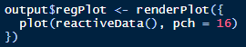
Outputs
Act like functions that re-run when an input changes (and they are viewable on the page -- lazy evaluation).
Two components:
UI Side: A location in your app
Server Side: Render function telling Shiny what to show
output$* <- render*({ })
ui
plotOutput(outputId = "regPlot")
server
output$regPlot <- renderPlot({ })
Notes:
({ }) it’s important to get this syntax correct

Slide 71
Output Syntax Variations
output$displayValue1 <- renderPrint({
input$sliderValue
})
output$displayValue1 <- renderPrint({
return(input$sliderValue)
})
output$displayValue1 <- renderPrint(input$sliderValue)

Slide 72
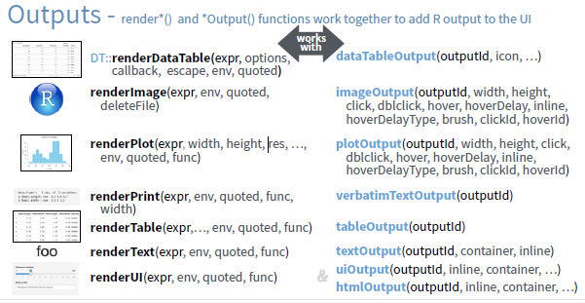
Other Outputs & Their Render Functions
Image from the R Shiny Cheatsheet https://shiny.rstudio.com/articles/cheatsheet.html
Notes:
Point out cool stuff w/ plotOutput() options like hover, dblclick, brush

Slide 73
Plot and Table Output Syntax Activity (2b_AddOutputs.R)
Short Individual Activity:
Add plotOutput and renderPlot
Add dataTableOutput and renderDataTable
Copy code from “#Code to place: ----” to make your data display
ui
plotOutput(outputId = "regPlot")
server
output$regPlot <- renderPlot({ })
Notes:
SHOW: The code that we’re placing can be run in the console to do the same things with loadedData since it uses no inputs (just like in a script) - show the plot and table previews - also possible to highlight and run directly from your app
outputId and it’s locations. It is the IMPORTANT piece of information that connects the WHAT will show up to WHERE its displays
NOTE: Outputs rerun when an input that they use is changed (reactivity)
NOTE: Plot outputs may re-render when the size of the window or the zoom changes because they have more/less space to display (you may see the note about this repeated multiple times in the console for the regression equation used)

Slide 74
Group Activity: Connection Outputs and Inputs (2c_ConnectInputsToOutputs.R)
Connect your outputs to your inputs
Plot output
Ways to step it up: Plot click events or hover
Examples: https://shiny.rstudio.com/articles/plot-interaction.html
Table output
Ways to step it up: Click a row in the table and get back it’s information
Examples: https://rstudio.github.io/DT/shiny.html
Table feedback
input$<TableOutputId>_rows_selected
https://yihui.shinyapps.io/DT-info/
Notes:
Live coding this activity. Between files __ and ___
Important Note: Sorting of the columns in the App changes what you’re looking at, but it won’t change the data that the app is using

Slide 75
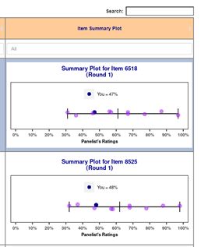
renderImage()
ui
imageOutput(outputId = "sample1")
server
output$sample1 <- renderImage({ })

Slide 76


renderPrint() and renderText()
ui
textOutput(outputId = "sample2")
server
output$sample2 <- renderText({ })

Slide 77


renderUI() for HTML and tags
ui
uiOutput(outputId = "sample3")
server
output$sample3 <- renderUI({ })

Slide 78
Other packages add more output options
{leaflet}
leafletOutput() renderLeaflet()
https://rstudio.github.io/leaflet/shiny.html
{plotly}
plotlyOutput() renderPlotly() ggplotly()
https://plotly-r.com/linking-views-with-shiny.html
{reactable}
reactableOutput() renderReactable()
https://glin.github.io/reactable/articles/examples.html#shiny
Notes:
Also {sortable} https://rstudio.github.io/sortable/
Better Plotly link:

Slide 79
Exporting Tables and Plots
Export Options
Save to your drive (when running locally)
write_csv()
ggsave()
Save to external/cloud drives (good for deployed apps)
Download button (good for local and deployed apps)
Saving function/code is provided and the user decides where to save the file you create
ui
downloadButton(outputId = “downloadRegPlot”, label = “Download Plot”)
server
output$downloadRegPlot <- downloadHandler(
filename = "RegressionPlot.png",
content = function(file) {
<saving code>
}
)
Notes:
Briefly mentioning some of the different ways to export/save data, plots, etc

Slide 80
Activity: Exporting Tables and Plots (2d_AddDownloadButton.R)
ui
downloadButton(outputId = “downloadRegPlot”, label = “Download Plot”)
server
output$downloadRegPlot <- downloadHandler(
filename = "RegressionPlot.png",
content = function(file) {
<saving code>
}
)
Add export buttons
Copy & Paste display code into the “content” area of the Handler and assign the plot/table to a variable
Save those variables using ggsave() or write_csv()
Notes:
Briefly mentioning some of the different ways to export/save data, plots, etc

Slide 81
Reactivity in Shiny Apps
Notes:
Understanding reactivity will enable us to
Create more efficient and sophisticated Shiny apps, and
Avoid the errors that come from misusing reactive values in R.

Slide 82



What is Reactivity?
One the great strengths of Shiny is that the applications we create are interactive.
Adding reactivity to your application is what creates interactive features.
Think about a spreadsheet:
If we input a value in one cell and use that value in formula in another cell, what happens?
What happens when we update the value in the first cell?
input$radius output$area
input$radius output$area
input$radius output$area
Notes:
Understanding reactivity will enable us to
Create more efficient and sophisticated Shiny apps, and
Avoid the errors that come from misusing reactive values in R.

Slide 83


Reactivity controls the data flow through an App
input$N
input$R
output$plot

Slide 84
Reactive values
We have talked pretty extensively about inputs in Shiny applications (thanks, Marcus!)
The list of inputs in your app are reactive values by definition.
When we slide a slider bar, the input value associated with bar stores the current value.
The input value will change when an app user changes the input.

Slide 85
Reactive functions
Reactive values are only useful within a reactive function.
If you attempt to use a reactive value in a regular function, you’ll get an error in your R console.
Error in .getReactiveEnvironment()
$currentContext() :
Operation not allowed without an active reactive context. (You tried to do something that can only be done from inside a reactive expression or observer.)

Slide 86
Reactivity happens in two steps
When a reactive value changes, it becomes invaild and notifies the functions that use that value.
The reactive function responds by updating the stored value to the new value and reruns the function.
Let’s take another look at our simple app from the opening.

Slide 87
The reactive toolbox
There are six major types of reactive functions that are useful when building Shiny apps.
Display output: The render*() functions (you have seen some of these)
Modularing: The reactive() function
Preventing reactions: The isolate() function
Triggering events: The observeEvent() function
Delaying reactions: The eventReactive() function
Managing states: The reactiveValues() function

Slide 88
Displaying output with render*
We already know some of these functions from generating output.
The structure of all render*() functions is the same:
render*({ CODE BLOCK })
The code block contain one or more reactive values.
The code block will respond with each update to a reactive value within the code block.
You can include as much or as little code as needed in between the curly brackets.

Slide 89
Displaying output with render*
Function | Outcome
renderDataTable() | An interactive table
renderImage() | An image (saved as a link to a source file)
renderPlot() | A plot
renderPrint() | A code block of printed output
renderTable() | A simple table
renderText() | A character string
renderVerbatimtext() | A character string format like console output

Slide 90
Modularizing Shiny code
with
reactive()
input$a
Expression()
output$z
output$y

Slide 91
Making modular code
We might need to perform some operations on your reactive values BEFORE you render the output.
You do not want to update an expression in two places.
you want to run a function using inputs and need the result to be reactive.
The reactive({}) function allows you to operate on reactive values to create a reactive expression that behaves a little like a data frame or tibble.
We can then call on this reactive object within other reactive functions.

Slide 92


Using reactive()
Notes:
A reactive expression is special in two ways:
You call a reactive expression like a function;
Reactive expression cache their values (the expression will return its most recent value unless it has become invalidated) to avoid unnecessary computation.
reactive() makes an object to use in downstream code. You can use it to modularize your apps.

Slide 93

Using reactive()
The app is it is now is generating two sets of random numbers.
What we would like to do is generate one set of numbers and use this set in both render*() functions
We need to build an in between step that contains our reactive values

Slide 94
Building reactive expressions in your code
data < - reactive( { rnorm(input$N, 50, 10})
The code block here contains reactive values and will respond when a reactive value is invalidated.
the code between the curly brackets will be used to regenerate the expression with each update.

Slide 95


Using reactive()
Notes:
A reactive expression is special in two ways:
You call a reactive expression like a function;
Reactive expression cache their values (the expression will return its most recent value unless it has become invalidated) to avoid unnecessary computation.
reactive() makes an object to use in downstream code. You can use it to modularize your apps.

Slide 96
Side-by-side code
Before
After

Slide 97
A few notes about reactive()
We need to call a reactive expression as if it was function with no arguments (e.g., in our example we used data() instead of data).
Reactive expression retain their values until a reactive value used in the expression is invalidated.

Slide 98
Activity 3a
Now, we will add some reactivity to a Shiny function. Open the file “3c_Task_1.r”
Use reactive() to create a reactive expression named “xy” that uses the code that generates data contained within renderPlot()
Replace the generating code in renderPlot with your new reactive expression
Create a new output named “xyvalues” using renderDataTable that displays the values of your newly created expression, “xy”, in a table just below the plot.
bonus: use options within renderDataTable to limit the display to 10 observations per page

Slide 99
Activity solution
Let’s look at the solution and walk through the code
Open the file “3c_task_1_solution.r”

Slide 100
Preventing reactions
Sometimes immediate reactivity can be problematic or inconvenient.
We can use the isolate() function to circumvent the reactivity of certain values.
if wrapped in isolate(), your app will treat a reactive value like its a normal R value.

Slide 101
Using isolate() to suppress a reactive value
isolate( { rnorm(input$N, 50, 10})
The object will not respond to changes in any reactive value in the code.
the code between the curly brackets will be used to create.

Slide 102


Using isolate() to suppress a reactive value

Slide 103
Triggering or delaying a reaction
Update
input$a
input$b
output$y
output$z
Using observeEvent() and eventReactive()
run(code)
input$a
output$y

Slide 104
Triggering or delaying a reaction
There are two reactive functions that are highly in shiny apps.
observeEvent() allow us to trigger a code chunk to run when a certain action takes place.
eventReactive() creates a reactive expression after a certain action takes place.
There are a number of ways to capture an action, but the most frequently used is with an action button.

Slide 105
Adding an action button
actionButton(inputId = "go", label = "Do it")
input function for an action button
name of input value
Display text
We can add a clickable button as an input on the UI side of our shiny app.
When we click on the button the input value takes on an integer values.
Each click increases the value by one.
The value of the action button is not useful, but we can use it within other reactive functions to trigger actions.

Slide 106


Adding action buttons

Slide 107
Triggering an action with observeEvent()
We can use observeEvent() to watch for updates to a reactive value (i.e., a click occurs) to trigger a piece of code to run.
We tie the observer to a reactive value (i.e, a action button input value).
When the reactive value changes, the observer invalidates and reruns.
observeEvent(input$go, {print(input$clicks) })
This is the reactive values that triggers the observer.
This code runs when the observer is invalidated (i.e., the reactive value updates).
The code in the brackets is treated like we used isolate()

Slide 108


Triggering an action with observeEvent()

Slide 109
Delaying an action with eventReactive()
We tie a reactive expression to delay creation until a reactive value (like the input from clicking on an update button) is satisfied.
data<-eventReactive(input$go, {rnorm(input$N)})
This is the reactive values that triggers the observer.
This code runs when one the action takes place and created the reactive object.
The expression in the brackets is treated like we used isolate().

Slide 110


Updating an expression with eventReactive

Slide 111
Activity 3h
Let’s build on the app we started in the last activity to add an update button that will delay the generation of our plot and table. Open the file “3h_task_2.r”
Add an update button below the other inputs in your app.
Delay the creation of your reactive expression until the update button is clicked using eventReactive.
Use observeEvent and renderPrint to create a printed message below your plot that says “You have updated your plot XX times” when you click the update button.

Slide 112
Activity solution
Let’s look at the solution and walk through the code
Open the file “3h_task_2_solution.r”

Slide 113
Creating your own reactive values with an input
reactiveValues()

Slide 114
Using reactiveValues()
Shiny applications often rely on user specified values gathered through our input widgets
Inputs cannot be overwritten programmatically, but this might be handy to do sometimes.
We can use reactiveValues() to create list of objects, not specified by the user, than can be used within a reactive context and manipulated programmatically.

Slide 115
One last useful input: inFile
We can us inFile on the ui side to navigate to and import external data files
inFile creates a set of reactive values with these elements
name (the file name)
size (uploaded file size)
type
datapath(the path to a temp file created on upload)
The values are used on the server side in reactive functions.

Slide 116

An short example of reactiveValues and InFile

